Slide 1



Course Project 1: Subfamily classification of glycoside hydrolase family
Siva Shanmugam (Postdoc)
Xinpeng Zhang (PhD student)
Yi Xing (Master student)
Department of Food Science and Technology
10/24/2024
PI: Yanbin Yin
Notes:
Hello everyone and we'll talk about the project today about Subfamily classification of glycoside hydrolase family. All tools and scripts are given by our postdoc Dr. Siva and I will go through all the parts and provide some hands-on demonstration.

Slide 2
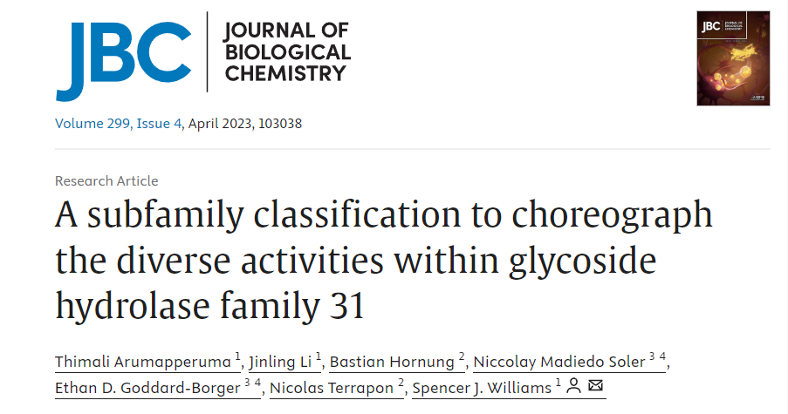
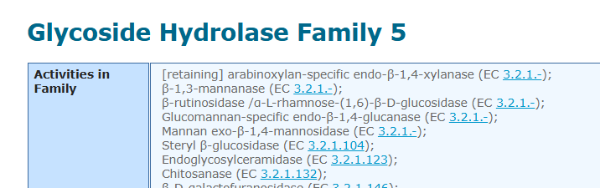
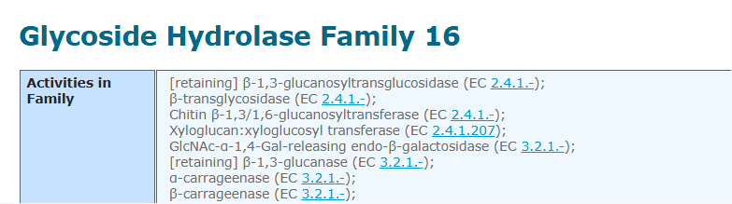
Introduction
Goal: Classify the CAZy family into subfamilies, analyze and visualize them using Bioinformatics tools and methods.
In this project, we will do CAZyme subfamily classification following the paper:
DOI: https://doi.org/10.1016/j.jbc.2023.103038
We will use GH31 as an example to show all analyses
Students will form two groups to work together on GH5 (group 1) or GH16 (group 2)
Notes:
we will be focusing on classifying the CAZy family into subfamilies. and to analyze and visualize them using bioinformatics tools and methods.
For this project, we are going to follow the methodology outlined in this paper
To give you a clearer picture, we'll be using GH31 as our primary example to demonstrate all the analyses we'll perform.
GH31 is a diverse and well-studied glycoside hydrolase family
Now, we need to divide the class into two groups. Group 1 will be working on GH5, another important glycoside hydrolase family, while Group 2 will focus on GH16. Each group will apply the classification and analysis techniques we discuss today to their assigned family.

Slide 3
Outline
1. Data preparation
2. Domain annotation
3. Domain extraction
4. Sequence similarity networks (SSNpipe)
5. Cytoscape Visualization
6. Phylogenentic Analysis
7. Other analysis
Notes:
/ɪkˈstrækʃ(ə)n/
/ˌfaɪloʊdʒəˈnetɪk/

Slide 4
Part I Data preparation

Slide 5
1.1 - Create Project Folders and Clone Git Repository
Log in your swan OnDemand and download all data to the work folder.
cd $WORK
mkdir course_project
cd course_project
git clone https://github.com/Keepingle/course-project-1-Subfamily-classification-of-glycoside-hydrolase-family.git
For each part, we recommend to create a folder and named with “part1”, “part2” ...
mkdir part1
cd part1
*Remember to do that and we won’t show it again in the next slides.
*NEVER forget which folder you are in and which you should be.
Notes:
/rɪˈpɑːzətɔːri/

Slide 6
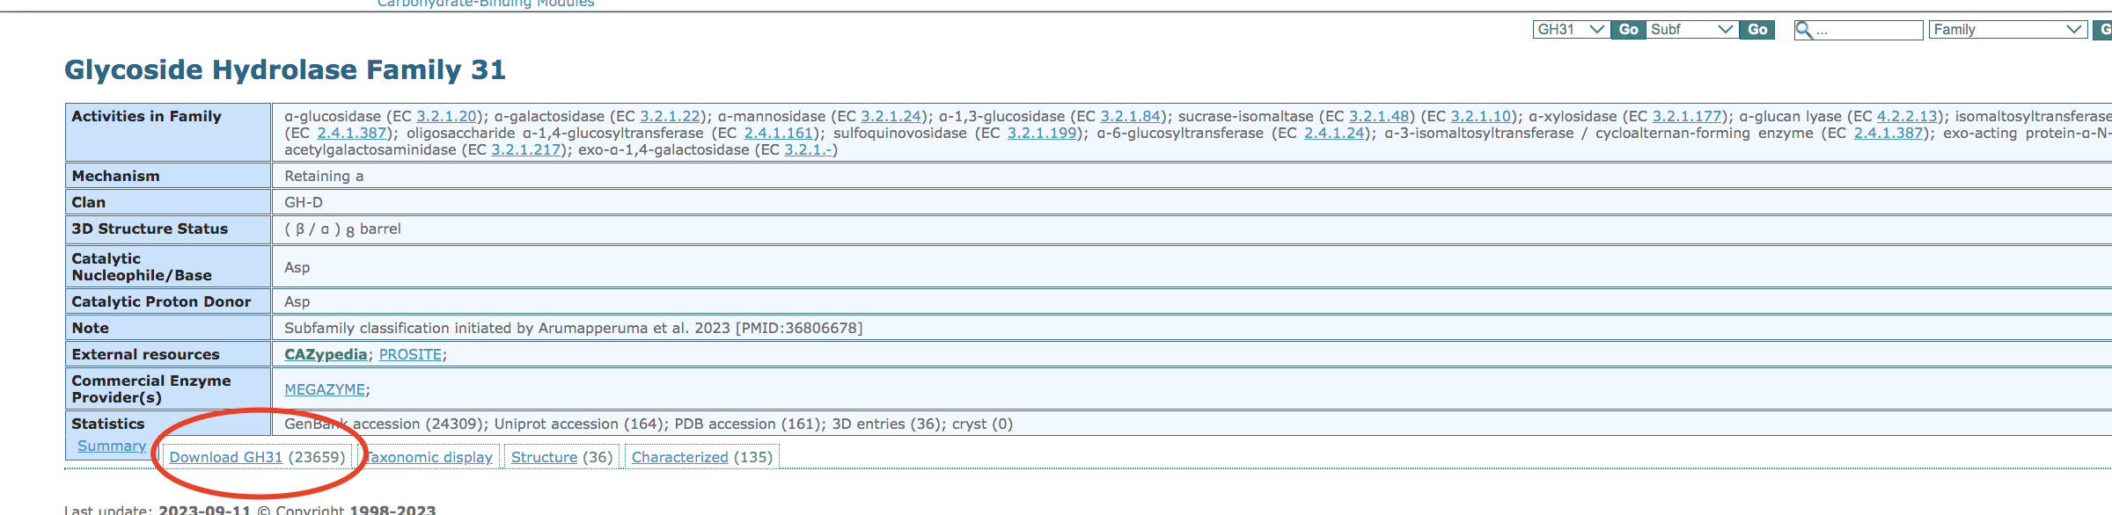
1.2 - Download and Process GH31 Family GenBank IDs
Go to the CAZy website http://www.cazy.org/
Select GH classes on CAZy database http://www.cazy.org/Glycoside-Hydrolases.html
Choose GH31 (change into your family) http://www.cazy.org/GH31.html
Find the txt file containing IDs

Slide 7
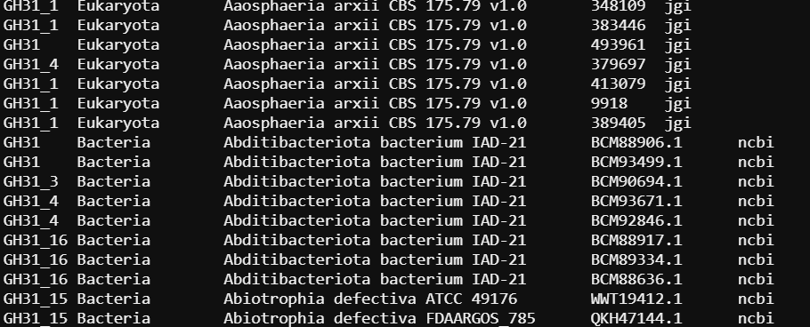
1.2 - Download and Process GH31 Family GenBank IDs
Copy the link and use the wget to download it on swan
wget http://www.cazy.org/IMG/cazy_data/GH31.txt
Use GH31.txt to get a list of genbank ids of GH31 family
less GH31.txt | grep -w ncbi | cut -f 4 > list_ids.txt
Columns in GH31.txt 1. Subfamily
2. Taxonomy: Domain
3. Organism: Species/Strain
4. Protein ID
5. Database

Slide 8
1.2 - Download and Process GH31 Family GenBank IDs
Copy the link and use the wget to download it on swan
wget http://www.cazy.org/IMG/cazy_data/GH31.txt
Use GH31.txt to get a list of genbank ids of GH31 family
less GH31.txt | grep -w ncbi | cut -f 4 > list_ids.txt
Remove the redundant IDs
cat list_ids.txt | sort | uniq > uniq_list_ids.txt
You will get 26863 unique ids in GH31
wc -l uniq_list_ids.txt

Slide 9
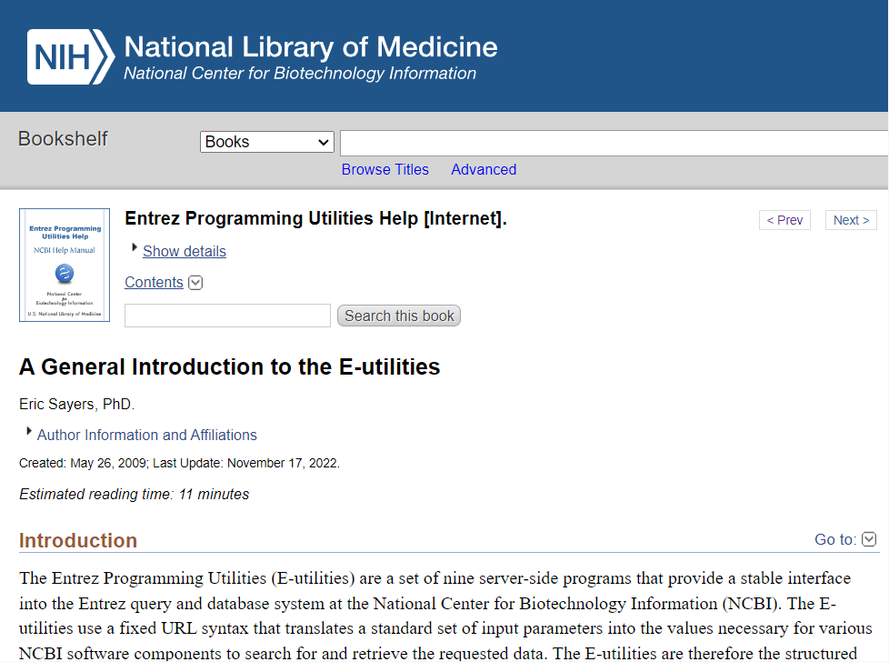
1.3 - Automating NCBI Data Retrieval with E-utilities and API Keys
The Entrez Programming Utilities (E-utilities) are server-side tools for automating queries and retrieving data from NCBI
NCBI has provided API keys that offer enhanced levels of supported access to the E-utilities
https://www.ncbi.nlm.nih.gov/books/NBK25497/
https://www.ncbi.nlm.nih.gov/books/NBK179288/

Slide 10
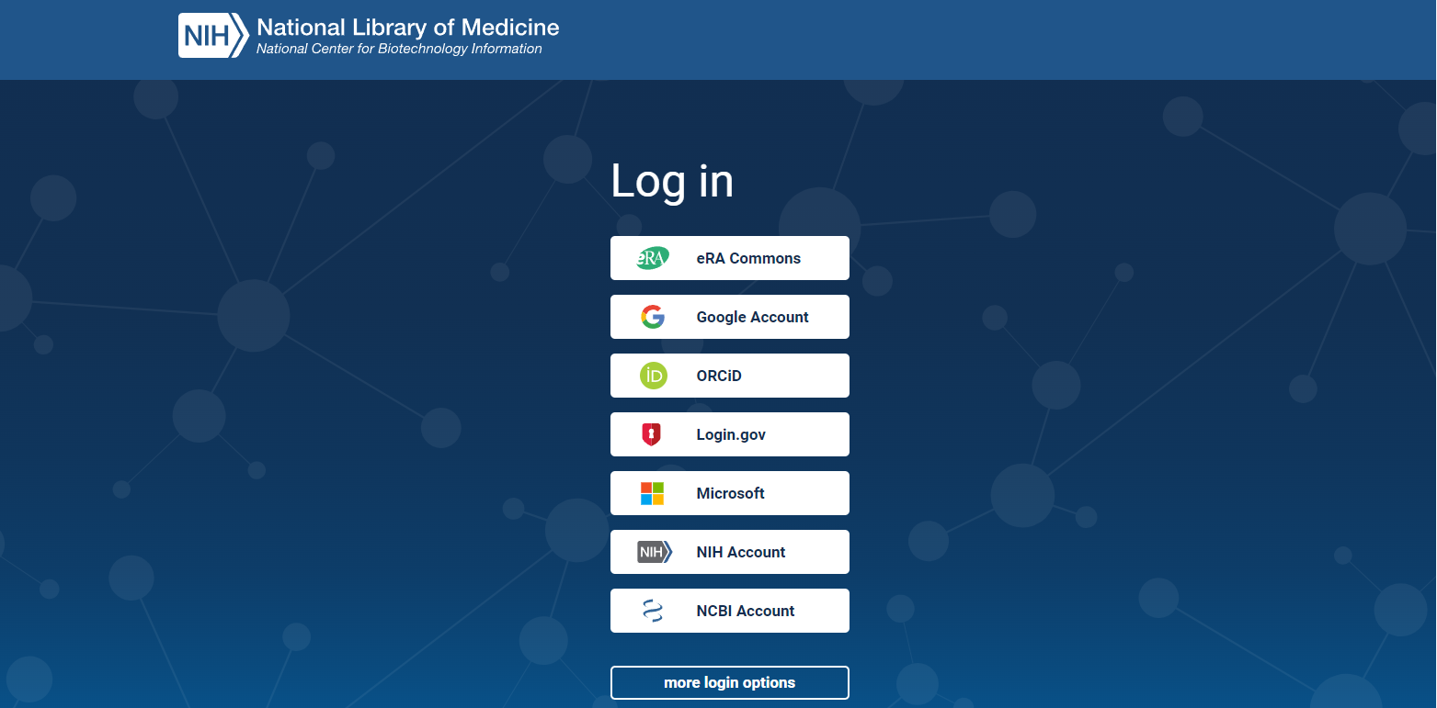
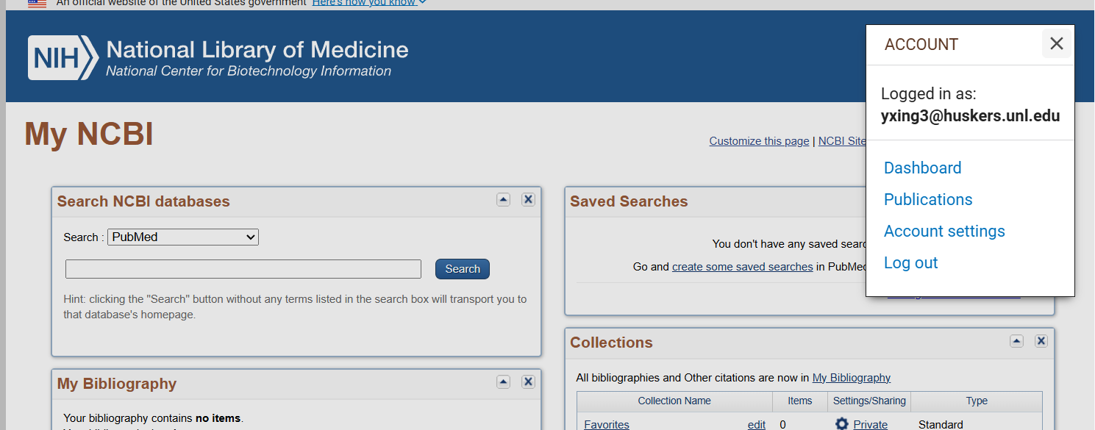
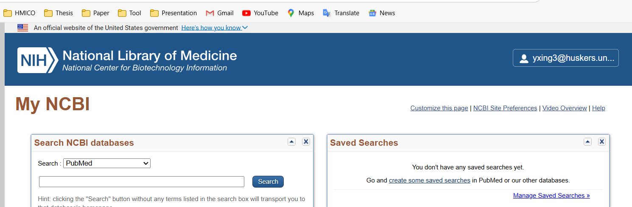
1.3 - Automating NCBI Data Retrieval with E-utilities and API Keys
Creating an NCBI Account (Recommended to Use Your UNL Account) https://account.ncbi.nlm.nih.gov/
Then go to the “Account settings”
Find your API key in the end.

Slide 11
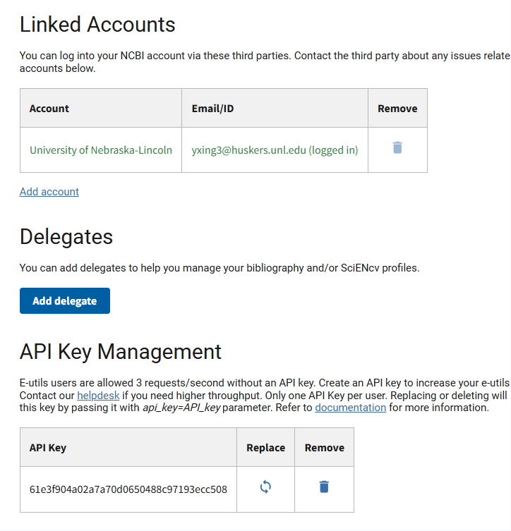
1.3 - Automating NCBI Data Retrieval with E-utilities and API Keys
Creating an NCBI Account (Recommended to Use Your UNL Account) https://account.ncbi.nlm.nih.gov/
Then go to the “Account settings”
Find your API key in the end.

Slide 12
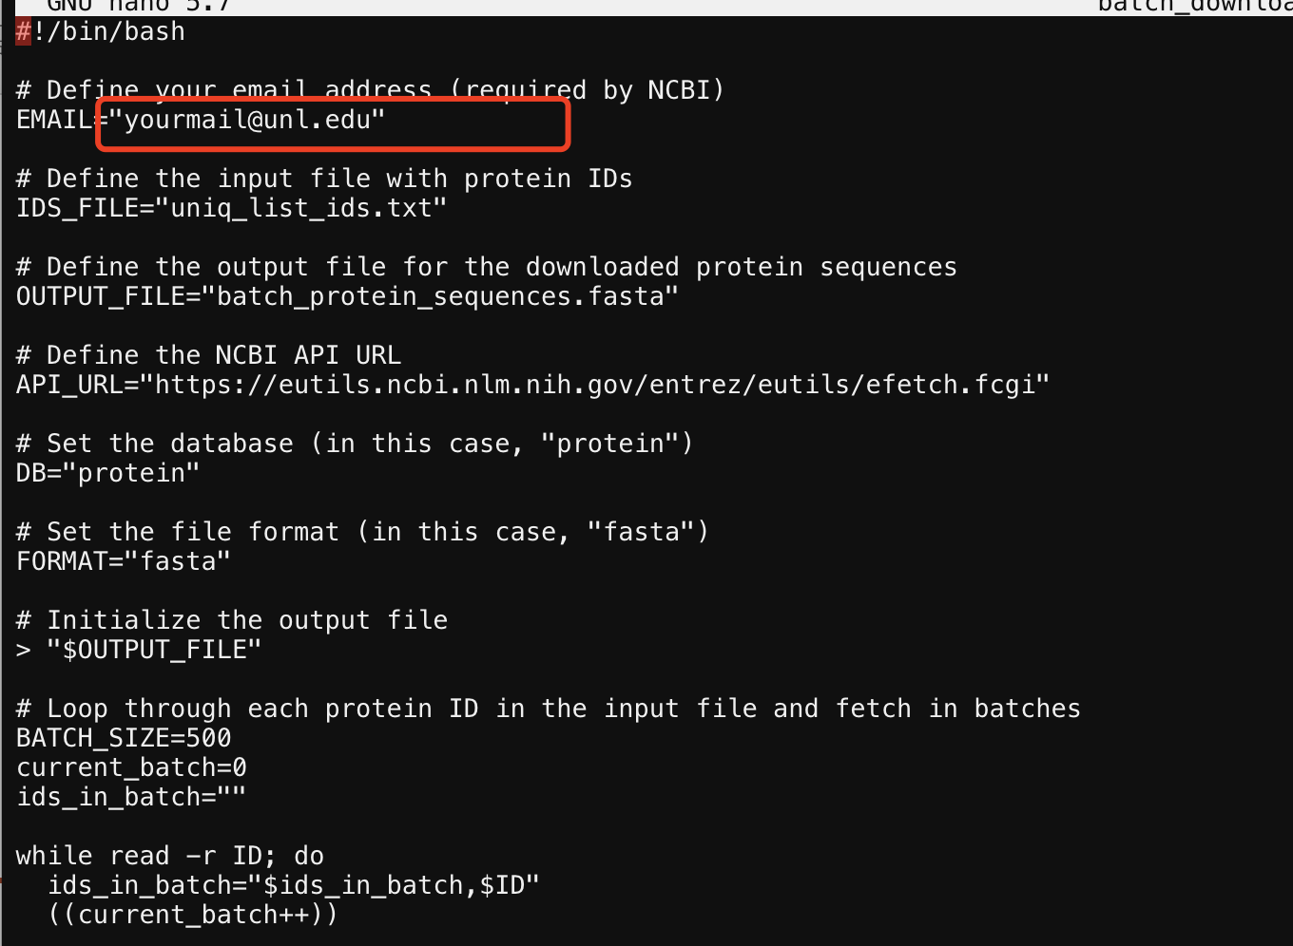
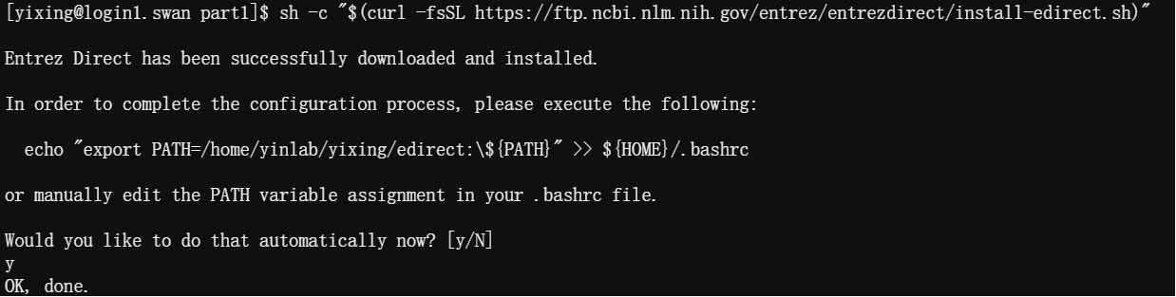
Run the following command:
sh -c "$(curl -fsSL https://ftp.ncbi.nlm.nih.gov/entrez/entrezdirect/install-edirect.sh)"
(Type y and click enter when it asks you to do it)
And use this command to set your NCBI API key
export NCBI_API_KEY=your_API_KEY
cp ../course-project-1-Subfamily-classification-of-glycoside-hydrolase-family/batch_download_protein_seqeunces.sh .
nano batch_download_protein_seqeunces.sh
Revise to change email address
The uniq_list_ids.txt file will be processed for this sh script

Slide 13
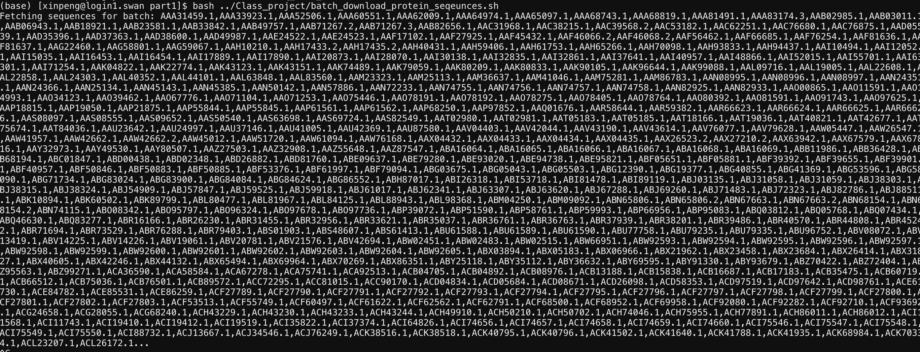
After that
bash batch_download_protein_seqeunces.sh
It takes ~30mins to downloading data.
26862 ids were found and downloaded.
Finally you get a file called “batch_protein_sequences.fasta”.

Slide 14
Part II Domain annotation
Create your part2 folder

Slide 15
2.1 - Domain Annotation of Protein Sequences Using HMMER and dbCAN
Go to the website:
https://bcb.unl.edu/dbCAN2/download/Databases/dbCAN-old@UGA/
Use wget to download “dbCAN-fam-HMMs.txt” and “hmmscan-parser.sh”
Use module load to activate hmmer on swan.
ml hmmer/3.3
hmmbuild -h #To check if it works or not.

Slide 16
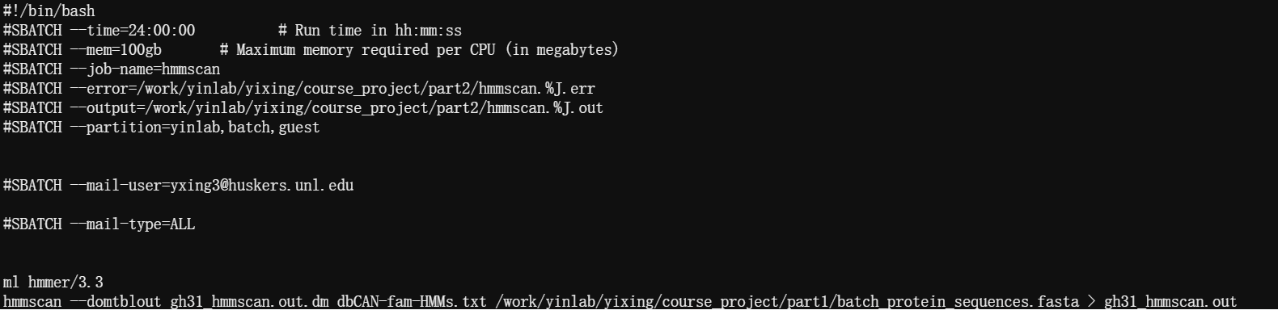
Then prepares the HMM database for faster searches:
hmmpress dbCAN-fam-HMMs.txt
cp ../course-project-1-Subfamily-classification-of-glycoside-hydrolase-family/hmmscan_run.slurm .
nano hmmscan_run.slurm
Edit it using your own info.
Try smaller mem if the waiting time is too long.
Set error and output with the same path (in your part2 folder).
Add email to remind you when it start/stop.
Remember where you have your GH31 protein sequence files.
It takes ~4hrs
Notes:
The hmmpress dbCAN-fam-HMMs.txt command compresses and indexes the HMM database to optimize it for faster and more efficient searches using HMMER tools like hmmscan and hmmsearch.

Slide 17
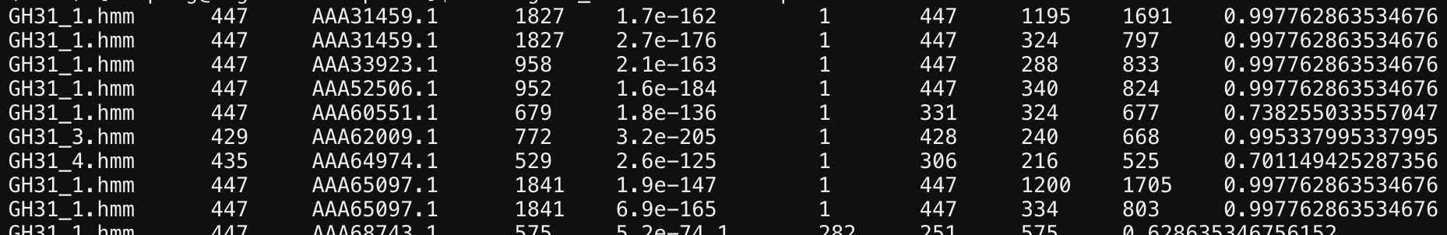
Run the following commands to make the result readable:
sh hmmscan-parser.sh gh31_hmmscan.out.dm > gh31_hmmscan.out.dm.ps
And extract the final modules by filtering with E- Value <1e-15 and coverage cut off >0.35
cat gh31_hmmscan.out.dm.ps | awk '$5<1e-15&&$10>0.35' > gh31_hmmscan.out.dm.ps.stringent
Columns in yourfile.out.dm.ps: 1. Family HMM 2. HMM length 3. Query ID 4. Query length 5. E-value (how similar to the family HMM) 6. HMM start 7. HMM end 8. Query start 9. Query end
10. Coverage
Notes:
HMM model family: These families are statistical models built from many similar sequences, capturing the characteristic features of the family. Each family represents a group of proteins/domains that share similar structure or function.
Family HMM: The HMM family that the query sequence matched (the protein family or domain represented by the HMM).
HMM length: The length of the HMM model in amino acids or nucleotides.
Query ID: The identifier of the query sequence being analyzed.
Query length: The total length of the query sequence in amino acids or nucleotides.
E-value: A statistical value indicating the similarity between the query sequence and the HMM family. Lower E-values mean higher similarity and more significant matches.
HMM start: The start position in the HMM model where the match begins.
HMM end: The end position in the HMM model where the match finishes.
Query start: The start position in the query sequence where the match begins.
Query end: The end position in the query sequence where the match finishes.
Coverage: The proportion of the HMM model that aligns with the query sequence, indicating how much of the model is covered by the match.

Slide 18
Part III Domain extraction
Create your part3 folder

Slide 19
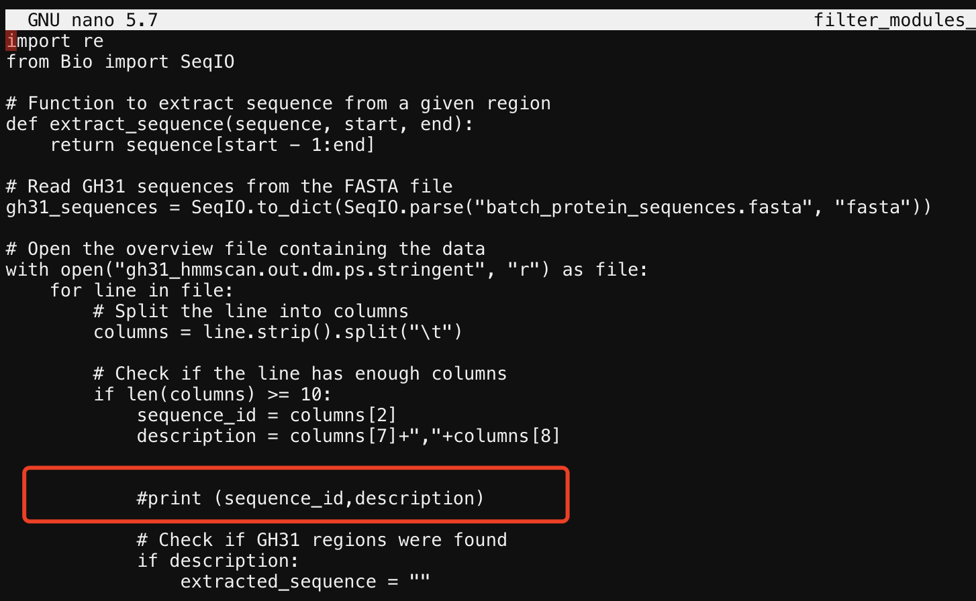
We give a python file to do that. First activate the biopython.
ml biopython
cp ../course-project-1-Subfamily-classification-of-glycoside-hydrolase-familyfilter_modules_26sep2023.py .
cp ../part1/batch_protein_sequences.fasta .
cp ../part2/gh31_hmmscan.out.dm.ps.stringent .
change the batch_protein_sequences.fasta
python filter_modules_26sep2023.py > extracted_domains.faa
Add “#” here if you didn’t get a fasta format file.

Slide 20
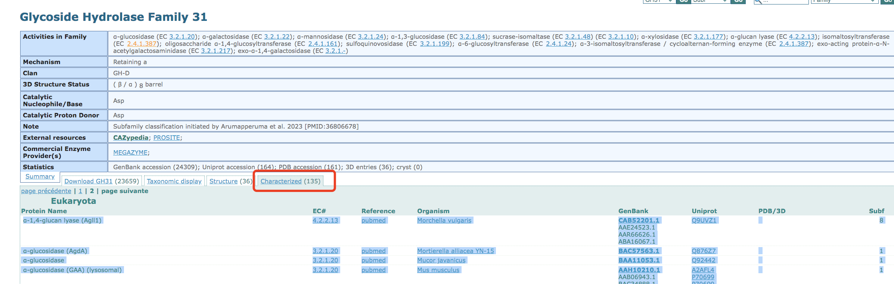
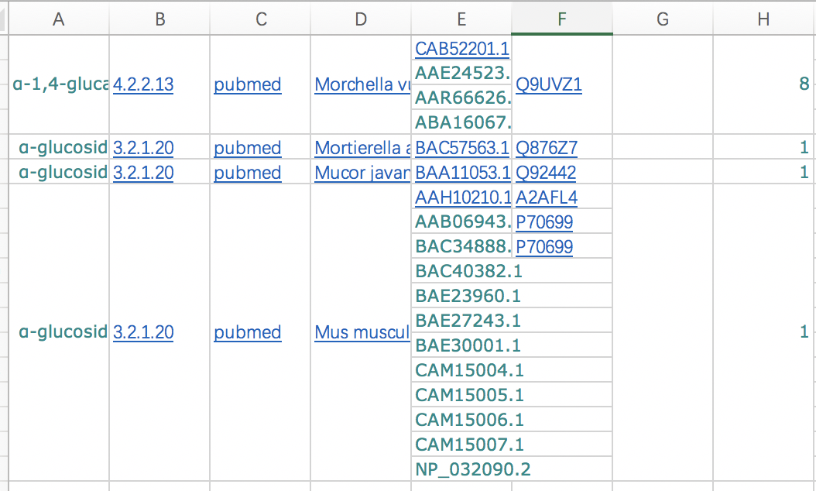
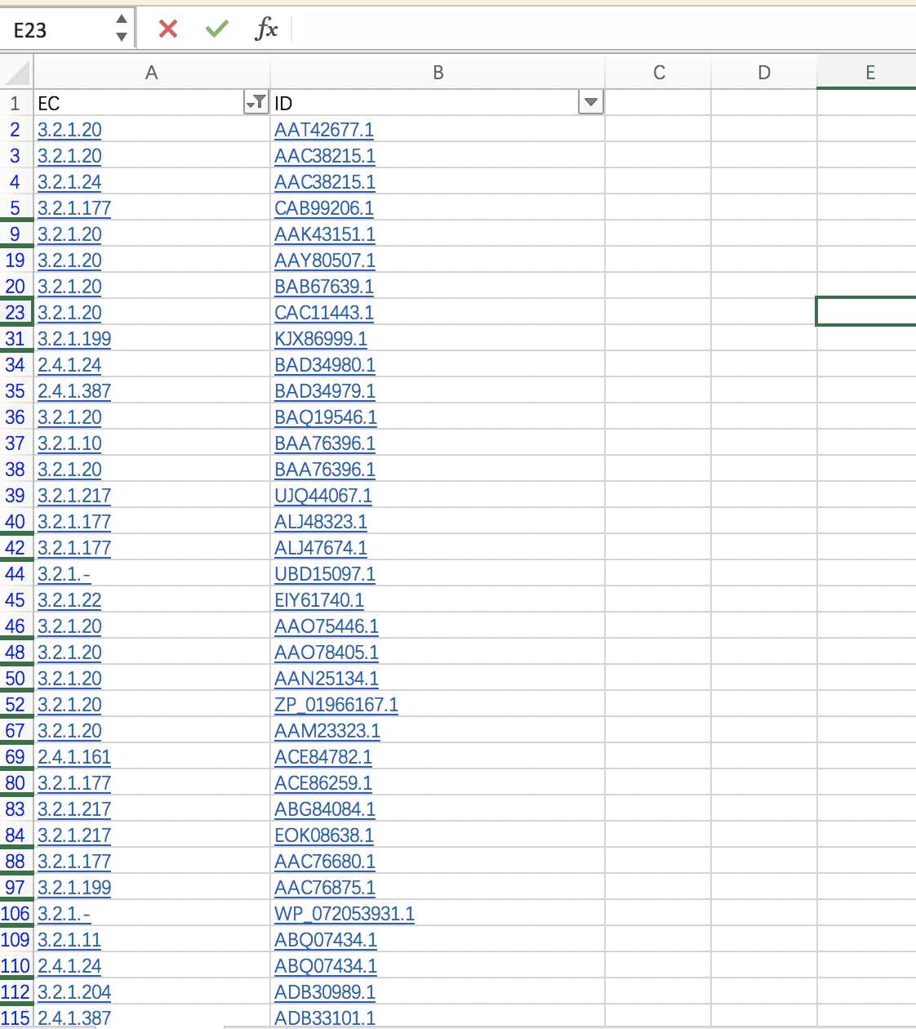
Go to the CAZy family page to get all characterized IDs.
Tabular column page will be shown.
Copy the Characterized IDs, EC numbers from the page and paste them in Excel and select only the IDs which only have hyperlinks (Characterized by CAZy) and make a list.
Copy those in the excel and revise it then use nano to make a txt file:
*There are some Genbank ID with multiple ECs, don’t forget to check, and keep all.

Slide 21
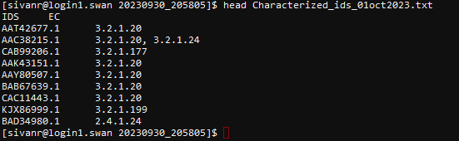
Finally get this result:
Name is “Characterized_ids_01oct2023.txt” (name could be changed but you also need to fix the program later).
The first row is IDS/EC

